Slide 1

Computer Communications
& Networks
CSNC-2413
Computer Networking:
A Top Down Approach
6th edition
Jim Kurose, Keith Ross
Addison-Wesley
March 2012
Ch 3 : TCP
Dr David Samuel
Faculty of Information Technology (FIT)
University of Central Punjab (UCP)

Slide 2
Chapter 3 outline
3.1 Transport-layer services
3.2 Multiplexing and
demultiplexing
3.3 Connectionless
transport: UDP
3.4 Principles of reliable data
transfer
3.5 Connection-oriented
transport: TCP
  segment structure
  reliable data transfer
  flow control
  connection management
3.6 Principles of congestion
control
3.7 TCP congestion control

Slide 3
TCP Connection Management
Recall:
TCP sender, receiver establish “connection” before exchanging data segments
initialize TCP variables:
  seq#
  buffers
  flow control info
  (e.g. RcvWindow)
Three way handshake:
Step 1: client host sends TCP SYN segment to server
  specifies own initial seq#
  no data
Step 2: server host receives SYN, replies with SYN-ACK segment
  specifies server initial seq#
  no data
Step 3: client receives SYN-ACK, replies with ACK segment; may contain data

Slide 4
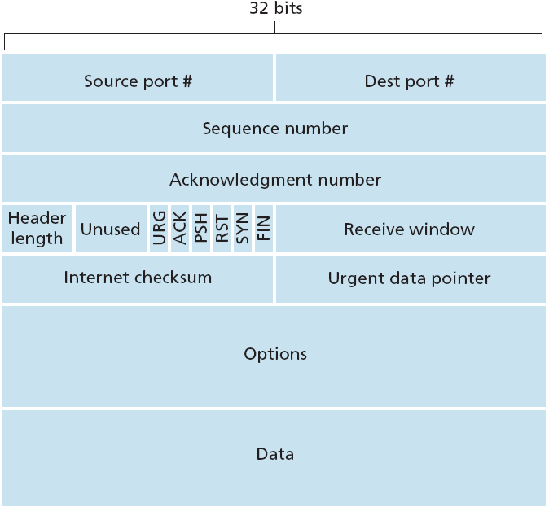
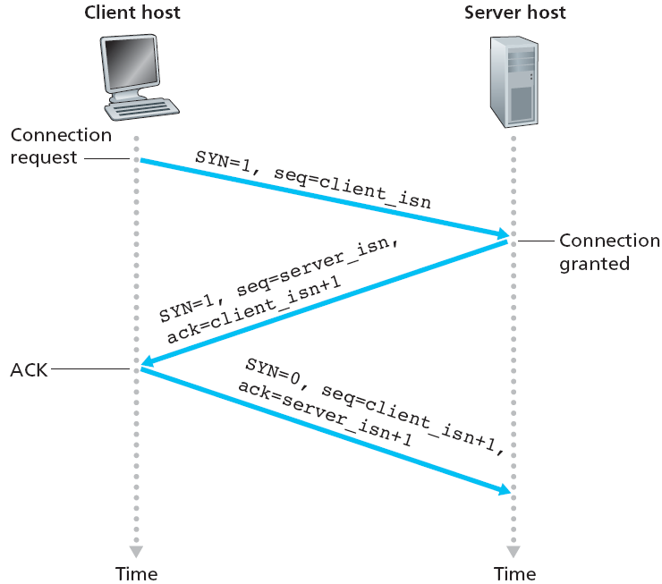
TCP three-way handshake

Slide 5
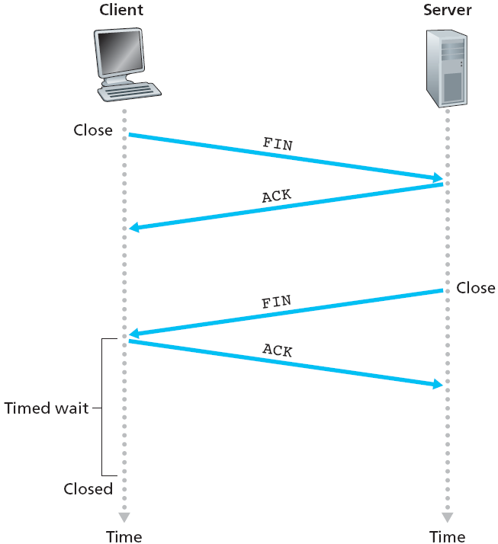
TCP Connection Management
Closing a connection:
client closes socket,
client end system sends TCP FIN segment to
server
server receives FIN, replies with ACK
server closes connection,
sends FIN segment
server receives ACK
Q: why don’t we combine ACK and FIN?
Server may be expecting some data still in pipeline!

Slide 6
Chapter 3 outline
3.1 Transport-layer services
3.2 Multiplexing and
demultiplexing
3.3 Connectionless
transport: UDP
3.4 Principles of reliable data
transfer
3.5 Connection-oriented
transport: TCP
  segment structure
  reliable data transfer
  flow control
  connection management
3.6 Principles of congestion
control
3.7 TCP congestion control

Slide 7
TCP Seq Numbers
TCP views Appl data as unstructured, but ordered, stream
of bytes
  Seq Num used over stream of transmitted bytes
  NOT over transmitted segments
  Seq Num in hdr is byte-stream number of first byte in segment
Example:
If a process in Host A wants to send 500 kB file to process in Host B, TCP sends the file as a byte-stream & numbers each byte
If MSS is 1,000 bytes, TCP constructs 500 segments
  first segment has Seq Num 0
  second segment has Seq Num 1000
  third segment has Seq Num 2000, and so on

Slide 8
TCP Ack Numbers
TCP is full-duplex
  Host A may receive data from Host B, while it sends data to Host B
  (as part of same TCP connection)
Each segment arriving from Host B to Host A, has a Seq Num for data from B to A
Ack Num that Host B puts in its segment is Seq Num of
the next byte Host B is expecting from Host A
Example:
Suppose Host B has received bytes 0 thru 999 from Host A, and is waiting for byte 1000 onwards. Also, it is about to send its own segment to Host A
  So, Host B puts 1000 in Ack Num field of the segment it sends to Host A

Slide 9
TCP Seq/Ack Numbers
last incoming segment
source port #
dest port #
Ack Numbers:
  seq # of next byte expected from other side
  cumulative ACK
Seq Numbers:
  byte stream “number” of first byte in segment’s data
Q: how receiver handles out-of-order segments
  TCP spec does not say,
  left upto implementor
sequence number
acknowledgement number
A
rwnd
checksum
urg pointer
window size
N
  sender sequence number space
sent
ACKed
sent, not-yet ACKed
usable
but not
yet sent
not
usable
source port #
dest port #
sequence number
acknowledgement number
rwnd
checksum
urg pointer
new outgoing segment

Slide 10
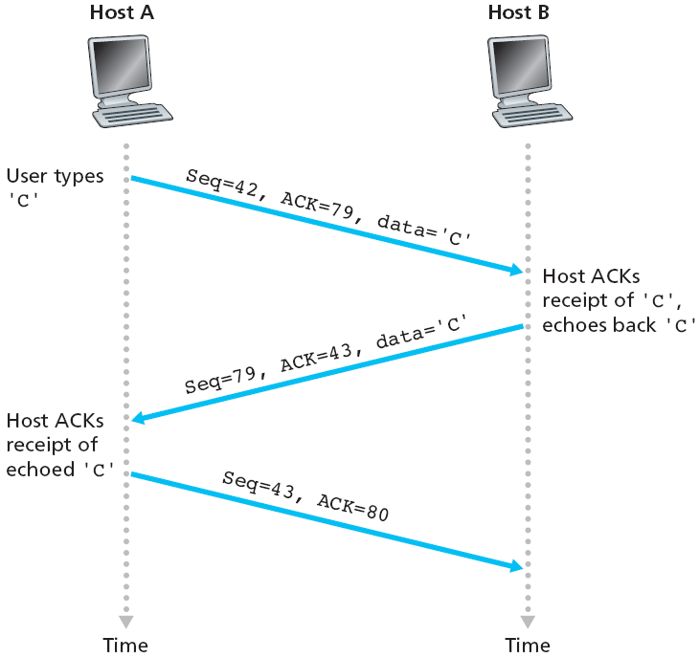
TCP Seq/Ack Numbers

Slide 11
TCP Round Trip Time & Timeout
Q: how to set TCP timeout value?
longer than RTT
  but RTT varies
  so, estimate RTT
too long: slow reaction to segment loss, poor performance
too short: premature timeout
  unnecessary reTx
Q: how to estimate RTT?
SampleRTT: measured time from segment Tx till ACK receipt
  ignore reTx
SampleRTT will vary; want estimated RTT “smoother”
  Estimated RTT is average of several recent measurements, not just current SampleRTT
tx
Estimated
RTT
tx
Estimated
RTT
Too short
retx
ack
Too long
ack
retx

Slide 12
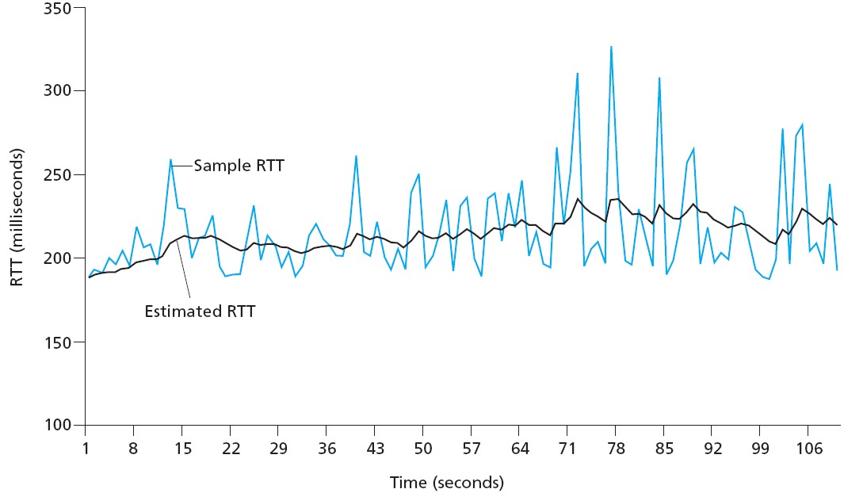
TCP Round Trip Time & Timeout
EstimatedRTT = (1- α)*EstimatedRTT + α*SampleRTT
exponentially weighted moving average (EWMA)
influence of past samples decreases exponentially fast
typical value: α = 0.125

Slide 13

TCP Round Trip Time & Timeout
Timeout interval:
  EstimatedRTT plus “safety margin”
  large variation in EstimatedRTT -> larger safety margin
First estimate SampleRTT deviation from previous EstimatedRTT…
DevRTT = (1-β)*DevRTT + β*|SampleRTT-EstimatedRTT|
(typically, β = 0.25)
Then compute new EstimatedRTT & Timeout as…
EstimatedRTT = (1- α)*EstimatedRTT + α*SampleRTT
TimeoutInterval = EstimatedRTT + 4*DevRTT
estimated RTT
“safety margin”

Slide 14
Practice Problem
Consider that Host A sends a TCP segment to Host B and measures the Sample RTT value as 106 ms. Assume that the value of Estimated RTT was 100 ms just before the sample was obtained, and the value of DevRTT was 5 ms. Using a value of α = 0.125 and β = 0.25, compute the TCP Timeout Interval after the RTT sample is obtained.
(First compute the DevRTT after the sample, then compute Estimated RTT, and lastly the Timeout value)

